Slide 1

DriverPass System Analysis
Nathan Vanderpool
Notes:
[No speaker notes required for this slide.]

Slide 2

System Requirements
Functional Requirements
User Authentication and Registration: The system must allow students/customers to create accounts by providing personal information (e.g., username, password, address, credit card details) and authenticate via login, with options for password reset via email, as depicted in the activity diagram for account creation and login flows.
Package Selection and Payment Processing: The system must enable users to select driving packages (e.g., package1, package2, package3), add credit card information, and process payments with approval/decline logic, integrating with a payment gateway to generate receipts and handle errors, aligning with the sequence diagram's transaction flow and class operations like selectPackage and callPayment.
Nonfunctional Requirements
Security: The system must implement encryption for sensitive data (e.g., passwords hashed, credit card details tokenized) and role-based access control to restrict actions, such as only administrators running reports or managing packages, ensuring compliance with standards like PCI DSS for payment handling.
Performance: The system must handle concurrent access by multiple users (e.g., students scheduling lessons simultaneously) with average response times under 3 seconds for key operations like login, reservation, and report generation, supporting scalability for up to 500 users during peak periods.
Notes:
[In your speaker notes, include an explanation of the different requirements you determined for DriverPass’s system. What are the functional requirements you selected to describe? What are the nonfunctional requirements you selected to describe? Be sure to explain how these requirements meet DriverPass’s needs.]

Slide 3
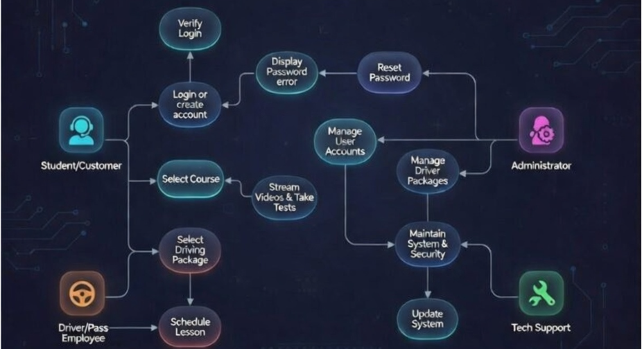
Use Case Diagram
Notes:
[Explain your diagram. Who are the different actors in the system? What are the different use cases? How did you account for DriverPass’s needs in your design? In your explanation, keep your audience in mind. Avoid the use of terms like “actors” and “use cases” in your explanation.]

Slide 4
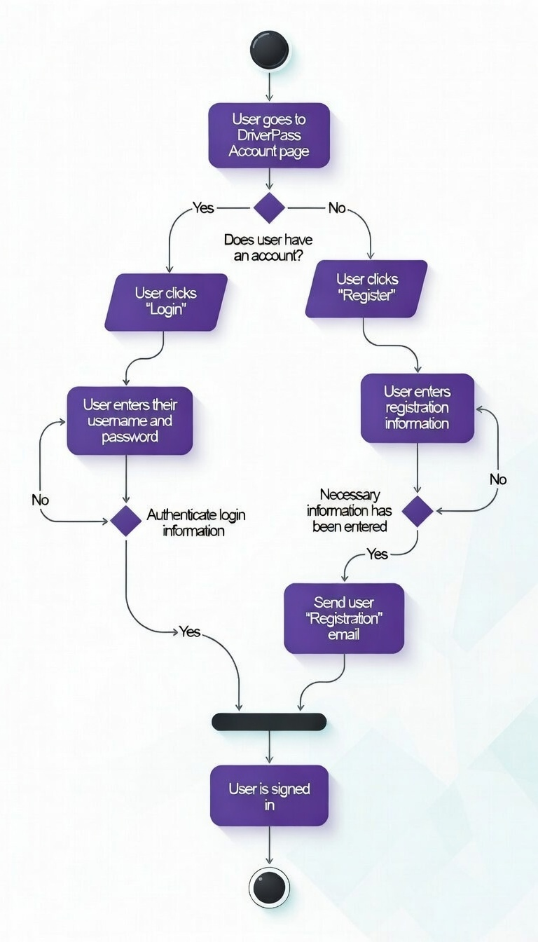
Activity Diagram
Notes:
[Explain your diagram. Which use case are you breaking down? What are the steps for this use case? How did you account for DriverPass’s needs in your design? In your explanation, keep your audience in mind. Avoid the use of technical terms such as “nodes,” “control flows,” and so on.]

Slide 5
Security
Authentication and Access Control: The design incorporates secure login mechanisms as shown in the Activity Diagram, with username/password verification and email-based password resets. Role-based access control (RBAC) is enforced via the Use Case and Class Diagrams, limiting actions such as report generation to Administrators and system updates to Tech Support, preventing unauthorized access.
Data Encryption: Sensitive information like user passwords, credit card details (userCreditCard in Class Diagram), and personal addresses (userAddress) is encrypted at rest in the database and in transit using HTTPS/SSL, protecting against interception during registration, login, and payment processes.
Payment Security: The Sequence Diagram's transaction flow (analogous to ATM) includes approval/decline logic with error handling for invalid cards or insufficient funds. Integration with PCI DSS-compliant payment gateways ensures secure handling of card information, tokenization, and compliance to prevent fraud during package purchasing.
Input Validation and Error Handling: Activity Diagrams show validation steps for user inputs (e.g., during registration and payment), including checks for correct credentials and card info, with error messages and redirects to mitigate injection attacks, invalid data, or brute-force attempts.
Audit and Monitoring: Administrators can run reports (e.g., monthly reports, invoices) as per the Class Diagram, enabling logging of user actions, reservations, and payments for auditing. This supports detection of anomalies, with Tech Support handling system updates to address vulnerabilities promptly.
Session Management: Post-login sessions are managed securely, with automatic logouts implied in flows, and limits on failed attempts (e.g., similar to the Sequence Diagram's PIN retry limit) to prevent unauthorized access after multiple failed logins.
Notes:
[How did you consider security in your design? In your explanation, keep your audience in mind by avoiding the use of technical terms.]

Slide 6
System Limitations
Limited Scope of Features: The current design, as reflected in the UML diagrams, primarily focuses on core functions such as user registration, login, package purchasing with payment processing, lesson scheduling/reservation, and basic administrative reporting (e.g., monthly reports and invoices). It does not include advanced capabilities like real-time instructor availability calendars with conflict detection, automated reminders/notifications via SMS/email for upcoming lessons, vehicle fleet management, progress tracking for student driving skills, integration with external licensing authorities, or support for in-person vs. online theory lessons.
No Support for Practical Driving Aspects: The system handles theoretical package selection, reservations (appointmentDate, instructorName, vehicle), and payments but lacks mechanisms for recording actual lesson outcomes, instructor feedback, student progress logs, or compliance with real-world driving test requirements, limiting its utility to administrative and booking tasks rather than full student training management.
Dependency on External Payment Gateways: Payment processing relies on third-party integrations (as implied by the sequence diagram's transaction approval/decline logic), meaning the system is vulnerable to downtime, API changes, transaction fees, or service disruptions from providers like Stripe or PayPal, which could interrupt package purchases and revenue collection.
Potential Scheduling Conflicts and Overbooking Risks: While the Class Diagram includes Driving Lesson Reservation with attributes like appointmentDate and instructorName, there is no explicit mechanism shown for real-time availability checks, instructor/vehicle assignment optimization, or prevention of double-bookings, which could lead to operational errors during high-demand periods.
Notes:
[What are the limitations of your design? In your explanation, keep your audience in mind by avoiding the use of technical terms.]

Slide 7
System Limitations (cont.)
Scalability Constraints for Growth: The design assumes a standard client-server web architecture with basic database storage, but it may face performance bottlenecks with significantly increased concurrent users (e.g., beyond initial assumptions), seasonal enrollment spikes, or expansion to multiple school locations, as no advanced load balancing, caching, or distributed database features are detailed.
Lack of Mobile Optimization and Accessibility Features: Although web-based and accessible on mobile devices, the diagrams do not specify responsive design details or support for native mobile apps, push notifications, or accessibility accommodations (e.g., for visually impaired users), potentially reducing usability for students scheduling on smartphones.
Security and Compliance Dependencies: While basic security measures (encryption, RBAC) are addressed, the system does not inherently include advanced protections like multi-factor authentication (beyond password), automatic vulnerability scanning, detailed audit trails for all actions, or built-in GDPR/PCI DSS compliance tools, relying on infrastructure and third-party services to fully mitigate risks.
No Offline Functionality: As a web-based system requiring internet connectivity for login, scheduling, payments, and reporting, it cannot support offline access or operations (e.g., instructors viewing schedules in low-connectivity areas), limiting flexibility in certain scenarios.
Notes:
[What are the limitations of your design? In your explanation, keep your audience in mind by avoiding the use of technical terms.]

